Slide 1
Brand and Marketing Guidelines
This document has been developed based on our current marketing policy and guidelines. If issues arise that haven’t been considered, we reserve the right to change these guidelines at our own discretion.

Slide 2
Brand Guidelines

Slide 3
Refresh Brand Essence
The Refresh brand features a clean look and feel
The designs should be clean, simple and straightforward
It’s best to avoid complicated busy designs

Slide 4
What does the Refresh brand mark represent / what was the inspiration?
The brief was to create a design that was fresh, modern and dynamic, not like a traditional building company, that tends to use darker more masculine colours and imagery, that usually suggest more about the building construction methods rather than creating a home.
We wanted to differentiate – To appeal to our target market, which is predominantly female , we created bright primary colours on a white background creating a minimalist aesthetic. That hinted at home style and comfort, not just the mechanics of building.
Three arrows in a geometrical composition facing inwards to suggest stability and strength, the forth facing outwards in the process of change to symbolise the act of renovation and high lighting the Refresh logotype.

Slide 5
Who Designed the Refresh brand mark?
Barry Bloomfield creates brand platforms that provide the graphic foundation for communications. He holds a Masters Degree in Design from the Royal College of Art in London.
Barry’s branding and design experience is substantial. He initially trained under the guiding eye of Terence Conran. His portfolio includes some of the best known brands in the world.
Achievements include: he designed the Sellotape logo (as a brand leader in the UK, Sellotape won Superbrands' Most Trustworthy Brand Award in 2003, beating Rolls Royce); he was on the team that put the star back into the Heineken logo; he designed the Lux soap packaging globally; he developed a new brand mark and completely redesigned the store layout of the Boots chain of pharmacies in the UK (one of the biggest household name brands in the UK); he designed the livery for a Formula 1 Ferrari. The list goes on and on.
Since moving to New Zealand in 1998, Barry has worked with companies including Lion Nathan, Merck, Sharp & Dohme, Gravity Coffee, Firstland Wines, Hansells, Fletcher Challenge, SC Johnson, Carter Holt Harvey and of course, Refresh Renovations!

Slide 6
Refresh Logo
1 - Primary Refresh Logo
This the primary Refresh Logo and the prefer version to use on marketing collateral and signage. The Refresh logo should where possible always be used on a white background.
2 - Secondary, Refresh Tower Logo
This the primary Refresh Logo and the prefer version to use on marketing collateral and signage.

Slide 7
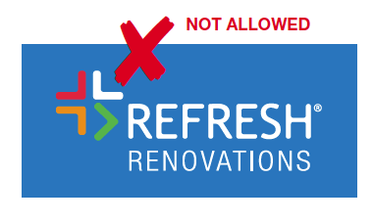
Refresh Logo (Prohibited Use)
Changing the colours of the logo to suit a background colour
It is prohibited to change any of the logo colours to
suit a specific coloured background.
Using a coloured logo on top of another colour
It is prohibited to use the Refresh logo in colour on
top of another solid colour.
Changing the colours of the logo
It is prohibited to change any of the logo colours.

Slide 8
Refresh Fonts
Print media
Heading font:
Helvetica Neue Medium Helvetica Neue Roman Helvetica Neue Light
Body: Helvetica Neue Roman
Digital media
Heading font:
Montserrat Bold Montserrat Medium
Body: Montserrat Regular
Presentations and CONTROL
Heading font:
Open Sans Bold
Body: Open Sans Normal

Slide 9
Refresh Main Colours
CMYK Colours
RGB (Hex) Colours
M:90
Y:75
C:89
M:43
M:52
Y:100
C:70
Y:90
#E73439
#0078BF
#F28E00
#50AF47
K:100
C:100
M:90
Y:73
K:40
C:89
M:43
White
(K:0)
#1D1D1B
#083851
#706F6F
#FFFFFF

Slide 10
Approved Messaging and Communication

Slide 11
Elevator pitch
What we do
We are a building company specialising in residential renovations.
We operate in NZ, Australia, the UK and USA
Why we do it
Homeowners typically have a very poor experience when renovating their homes.
Refresh Renovations is here to change how the world renovates.
So that homeowners get a result to be proud of with the minimum amount of pain.
How we do it
By delivering a business model that connects customers to the best people and processes, via a unique technology platform that makes life easier for everyone.
Our scale and our relationships give any homeowner access to world-class project management, customer service, attention to detail and workmanship.

Slide 12
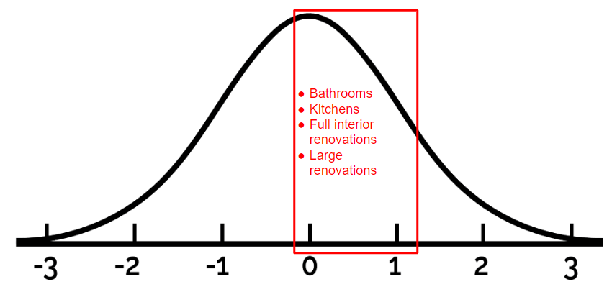
Target Demographic
Target demographic
We are going for the mass market. We want to be positioned in the upper middle, not at the high end. This is where the vast dollar volume of the market is.
Customers want value for money and franchisees need to educate them on how our process provides value for money.
Franchise business unit structures are designed so they can be scalable and handle a large number of projects at a time.
Focusing on the high end is very high risk as there are far fewer projects. Franchisees need to focus on a large number of projects with a market representative mix of large, medium and small.
Our audience motivation is
To have a lovely home to bring up their family and socialise with friends
To have the peace of mind of engaging a national brand
To have someone who will look after the project from concept to completion
To have the reassurance that the project will be well managed and avoid the risks of budget and timelines blowing out
We are not targeting:
Landlords and commercial customers who are not motivated by the points above and will want to break up the project into its components and want to tender each component.
The exclusive highest end of the market who are looking for 'trophy' architects.
The bottom end of the market who are cash strapped and will want to do parts of the project themselves

Slide 13
What we sound like, and what we don’t
MORE OF THIS
LESS OF THIS
You’ll always feel in Control
Our online dashboard gives full access to your projects

Slide 14
What we sound like, and what we don’t
MORE OF THIS
LESS OF THIS
Create a home you’ll be proud of
Choose from premium materials

Slide 15
What we sound like, and what we don’t
MORE OF THIS
LESS OF THIS
Why you’ll
be happy you chose us
Why we’re the best

Slide 16
What we sound like, and what we don’t
MORE OF THIS
LESS OF THIS
Relax knowing you’re getting value from your budget
We won’t be beaten on price

Slide 17
Acceptable Ad Formats

Slide 18
What is accepted
The following is permissible on the ads
Phone numbers that terminate at Head Office
Enquiry forms that connect to Control with correct UTM parameters configured
Well designed ads that meet the brand guidelines
Ads that champion the brand
Ads that follow the brand guidelines / have been put forward by a franchise and accepted into the Brand Guidelines
Well crafted advertising messages that promote our offer (view this page for inspiration)
Advertising can and should be creative, but stay within the guidelines and position the brand correctly

Slide 19
Approved elements for change
The following items may be customised by franchisees on ads and flyers
Franchisee photo
Headlines (see Page 27 of Brand and Marketing Guidelines for pre approved headlines. Other headlines to be submitted for approval to Refresh Head Office)
Renovation project photography (franchisee projects may be used or stock photography)
Phone number may be changed to a Franchisee 0800 / 1800 number (only Refresh Head Office issued Numbers can used)
Team member photos and bio’s
QR code may be added (pointing to Franchisee’s profile page on Refresh website only)
Website address (pointing to Franchisee’s profile page on Refresh website only)

Slide 20
Approved Headlines
The below headlines are preapproved for use. Other headlines require approval from Refresh Head Office before use.
Your local home renovation specialist
Your local home renovation experts
We’re changing the way the world renovates
The Refresh process makes renovating easy
A fresh approach to renovations
Home renovation specialists
Designer bathrooms and custom kitchens
Relax and let Refresh take care of your renovation
House overdue for a renovation?
Kitchen overdue for a renovation?
Bathroom overdue for a renovation?
Refresh will manage your renovation for you
From small projects to complete home renovations

Slide 21
Approved Copy
The copy below is pre approved for use. Other copy requires approval from Refresh Head Office before use.
Word Count: 67
Refresh is <country>’s leading builder that specialises in renovations.
As a design and build specialist, we make things easy by being your one point of contact for the entire renovation process. We have the designers, builders and sub-trades to complete the job on time, on budget and to a high quality.
Talk to <franchisee> today and find out how they and their team can transform your home.
Word Count: 64
Refresh is your local home renovation specialist - we’re locals who live in the area and can manage your project for you from start to finish. Refresh Renovations can renovate kitchens and bathrooms right through to complete home renovations. Using our online customer portal you can track your project remotely including specifying products and seeing pictures and videos from site. Talk to us today.
Word Count: 68
As a design and build specialist, we make things easy by being your one point of contact for the entire renovation process. We have the designers, builders and subcontractors to complete the job on time, on budget and to the highest standards.
Design and build specialists
Better value and a better experience
End-to-end project management
Streamlined client communication
One point of contact makes it hassle-free
Interior design advice

Slide 22
Approved Copy continued
The copy below is pre approved for use. Other copy requires approval from Refresh Head Office before use.
Word Count: 41
Refresh is New Zealand’s leading builder that specialises in renovations. Working with Refresh, you can be assured that your renovation will be cost-effective and hassle free. We work with you, within your budget to design and deliver the home you want.
Word Count: 52
Your local home renovation specialists:
We’ll manage the entire project for you
Cloud based software so you can view progress and make product choices online
Specialists at completing projects for out of town clients
We do all types of renovations from kitchens and bathrooms to complete home makeovers
Word Count: 75
As a design and build specialist, we make things easy by being your one point of contact for the entire renovation process. We have the designers, builders and sub-trades to complete the job on time, on budget and to the high
We specialise in:
• Extensions
• Kitchen renovations
• Bathroom renovations
• Warm up your home
• Adding a second storey
• Create open-plan spaces
• Indoor / outdoor flow
• Loft room conversions

Slide 23
Local Print ad examples
Refresh Ad
W205mm x H142mm
Download Open Files
Headline in Montserrat
Tracking -25 (Metrics)
Highlighting that Refresh are the experts
Approved messaging
Correct fonts as per brand guidelines
Inspirational imagery
Photos of team in conjunction with aspirational imagery
Refresh logo on white background
0800 number that terminates at head office

Slide 24
Site signage
Artwork
Available in via online ordering sites (find via LMS)
Logo on white background
Disclaimer
If you are working on a project outside of your territory, you are not able to show your contract details on signage - view excerpt for more information
Inspirational imagery
Approved messaging
QR code with your own trackable URL
Personal trackable 0800 number (must terminate at Franchisors call centre)

Slide 25
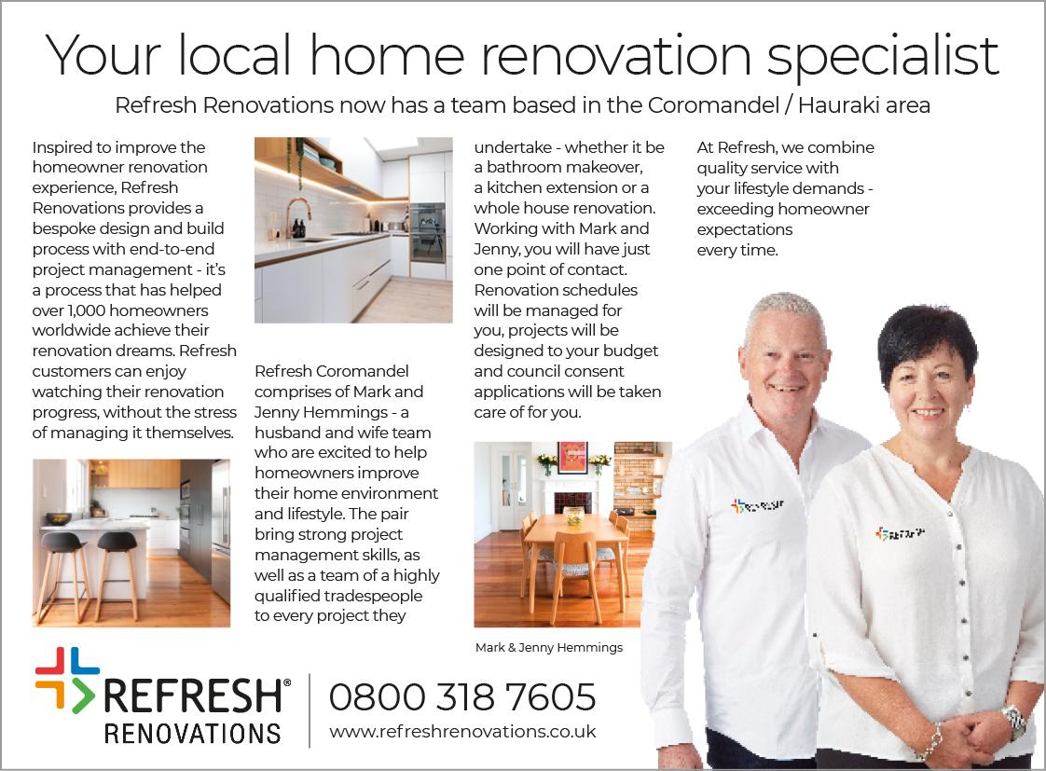
Local Print Editorial
Refresh Editorial
W190mm x H140mm
Download Open Files
Headline in Montserrat
Tracking -25 (Metrics)
Approved messaging
Highlighting that Refresh are the experts
Correct fonts as per brand guidelines
Photos of Franchisees in white shirt
Inspirational imagery
0800 number that terminates at head office

Slide 26
Digital Search Engine Advertising Examples
Highlighting that Refresh are the experts / leaders
BrisbaneEast.RefreshRenovations.com.au
Approved messaging
Refresh Renovations | Changing the way the world renovates
Call to action leads to website with enquiry that is captured into Refresh CONTROL
Refresh Renovations is here to change how the world renovates so that homeowners get a result to be proud of with the minimum amount of pain.
Get in touch today to discuss options and ideas for your home renovation project.
Design + build specialists | Taking your project from concept to completion | Kitchens | Bathrooms | Extensions | Full home renovations | We complete projects from all types and sizes
Highlighting we do projects of all sizes

Slide 27
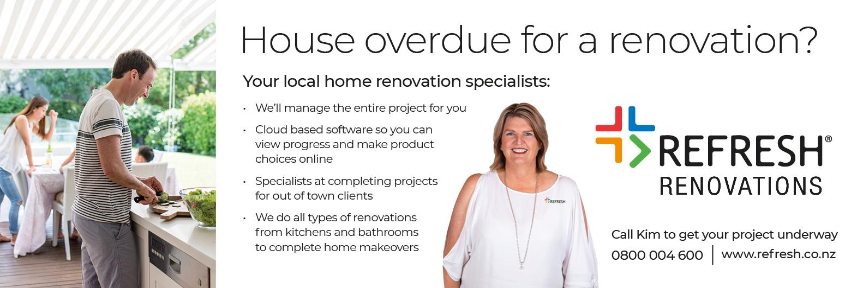
Local print ads and artwork
Refresh Ad
W266mm x H90mm
Download Open Files
Headline in Montserrat
Tracking -25 (Metrics)
Lifestyle photo
Refresh logo on white background
Body Copy in Montserrat Regular
Tracking -25 (Metrics)
Photos of people in white shirt (can be franchisee or stock photo)

Slide 28
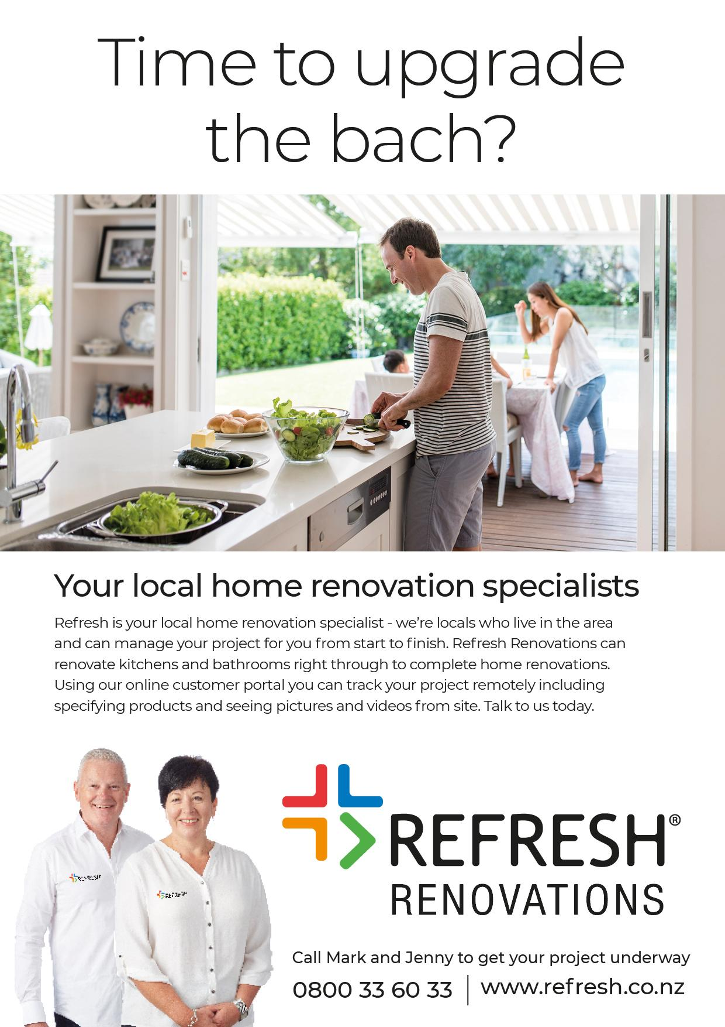
Local print ads and artwork
Refresh Ad
A4
Download Open Files
Headline in Montserrat
Tracking -25 (Metrics)
Lifestyle photo
Body Copy in Montserrat Regular
Tracking -25 (Metrics)
Photos of franchisee in white shirt (can be franchisee or stock photo)
Refresh logo on white background

Slide 29
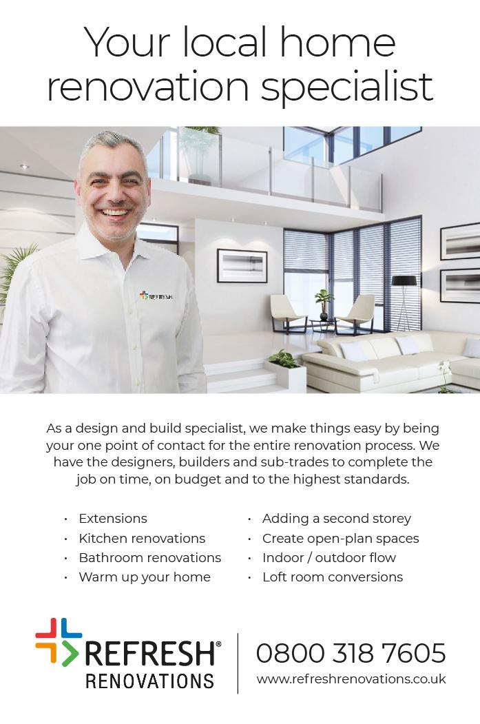
Local print ads and artwork
Refresh Ad
W118mm x H178mm
Download Open Files
Headline in Montserrat
Tracking -25 (Metrics)
Photos of people in white shirt (can be franchisee or stock photo)
Inspirational photo
Body Copy in Montserrat Regular
Tracking -25 (Metrics)
Refresh logo on white background

Slide 30
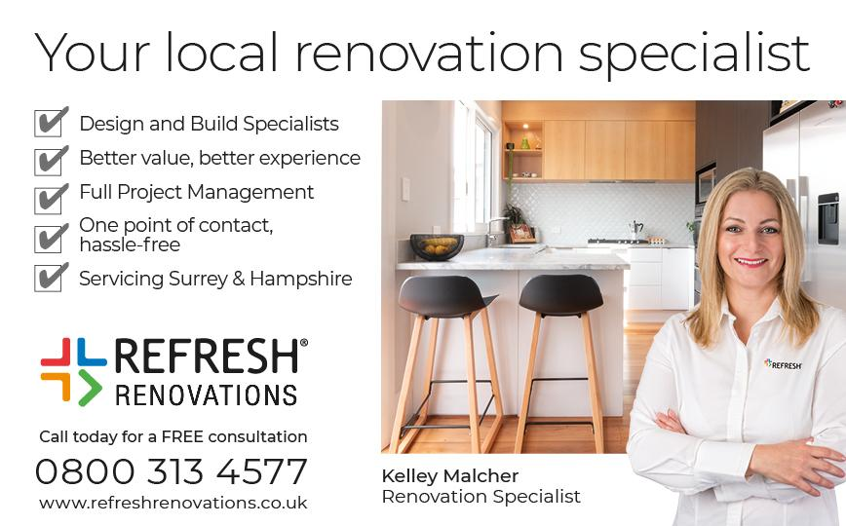
Local print ads and artwork
Refresh Ad
W147mm x H91mm
Download Open Files
Headline in Montserrat Tracking -25 (Metrics)
Inspirational photo
Body Copy in Montserrat Regular Tracking -25 (Metrics)
Refresh logo on white background
Photos of people in white shirt (can be franchisee or stock photo)
0800 number that terminates at head office

Slide 31
Local print ads and artwork
Refresh Ad
W254mm x H182mm
Download Open Files

Slide 32
Double Page Spread Magazine advertisements
Refresh Ad
DPS (A3)
Download Open Files
Headline in Montserrat
Tracking -25 (Metrics)
Inspirational photo
Refresh logo on white background
Body Copy in Montserrat Regular
Tracking -25 (Metrics)

Slide 33
Digital Banner Advertising Examples
Refresh Digital Banners
Download Open Files
Headline in Montserrat
Tracking -25 (Metrics)
Lifestyle photo
Photos of people in white shirt (can be franchisee or stock photo)
Refresh logo on white background

Slide 34
Facebook / Google Ads - Campaign Examples
Refresh 1080 Ads
1080 x 1080px
Download Open Files
Inspirational photo
Headline in Montserrat
Tracking -25 (Metrics)
Refresh logo on white background
Person in white shirt
Notes:
Because we began to receive a lot of requests from franchisees about wanting to create their own social media accounts and engage with their customers,

Slide 35
Acceptable Flyer Formats

Slide 36
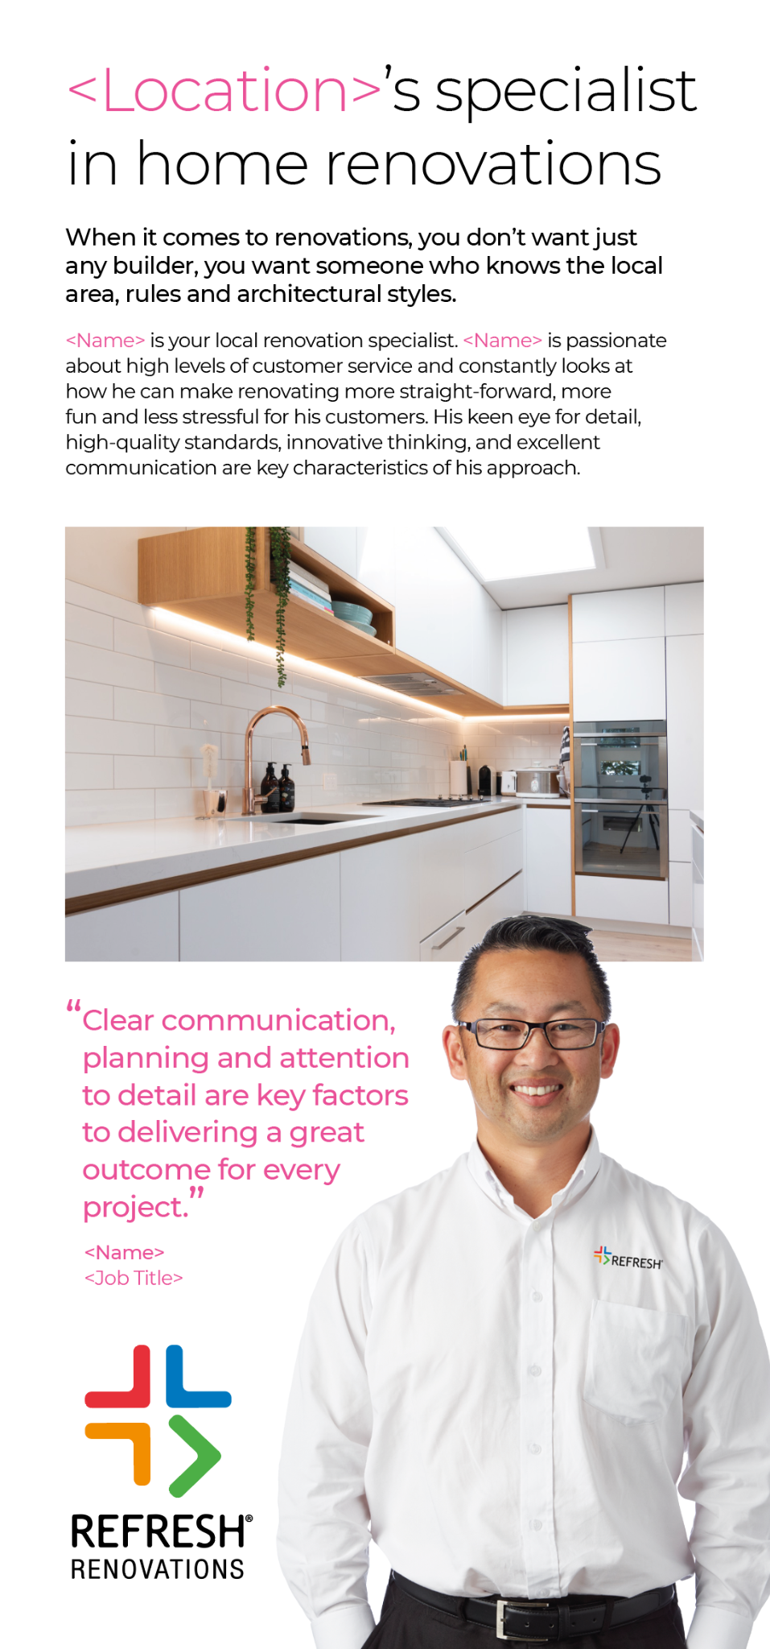
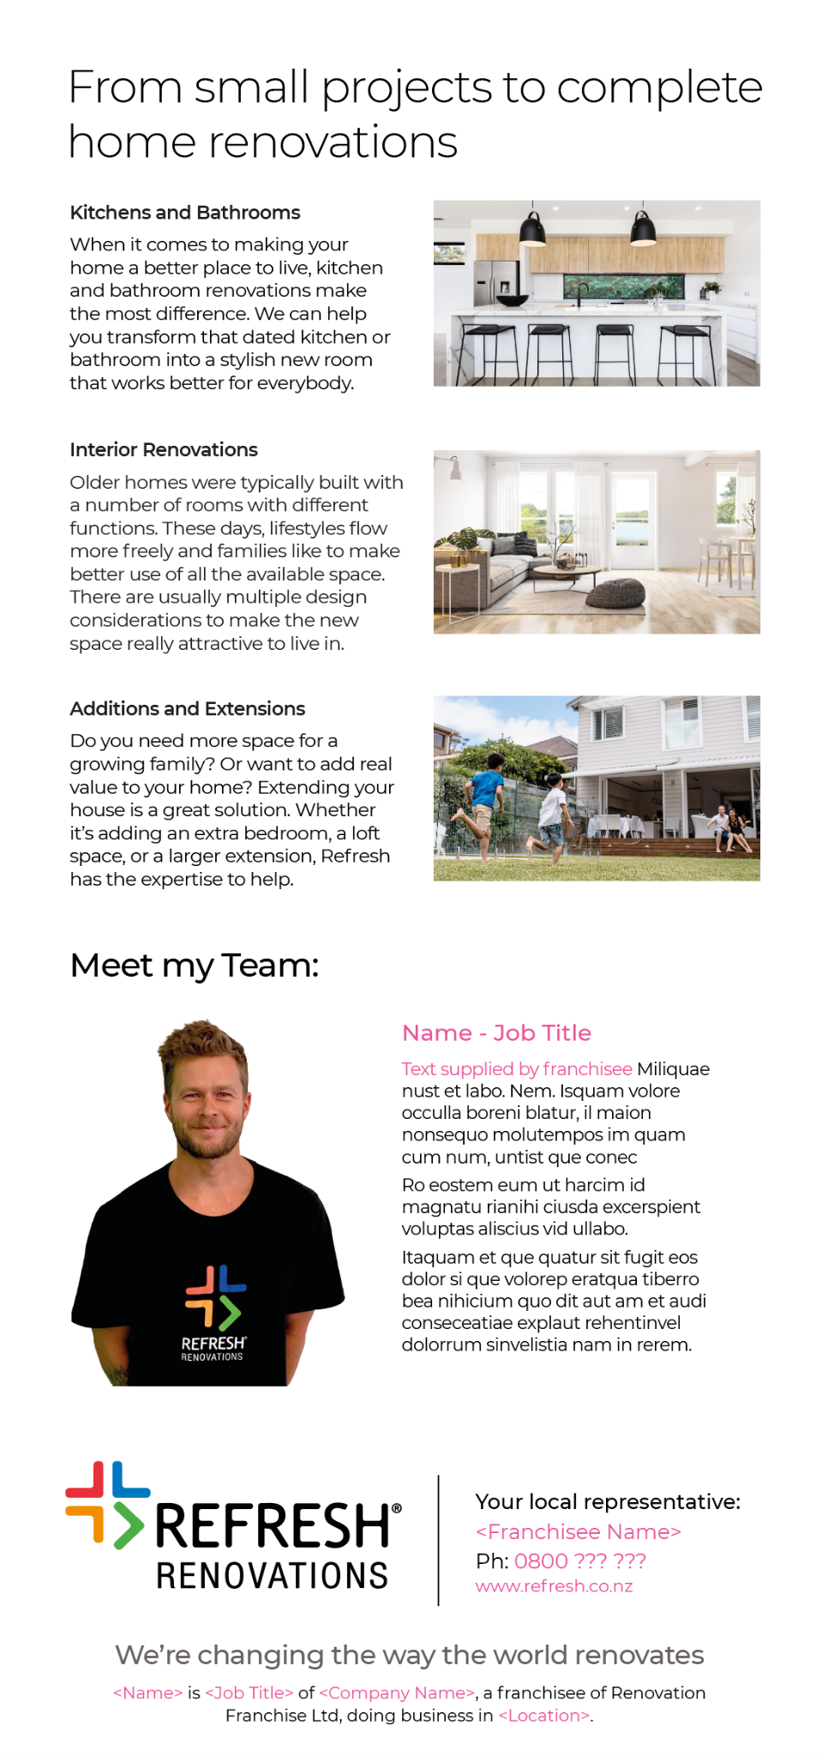
Team Flyer (printed and inserted into 5 step brochure)
Team Flyer
Download Files

Slide 37
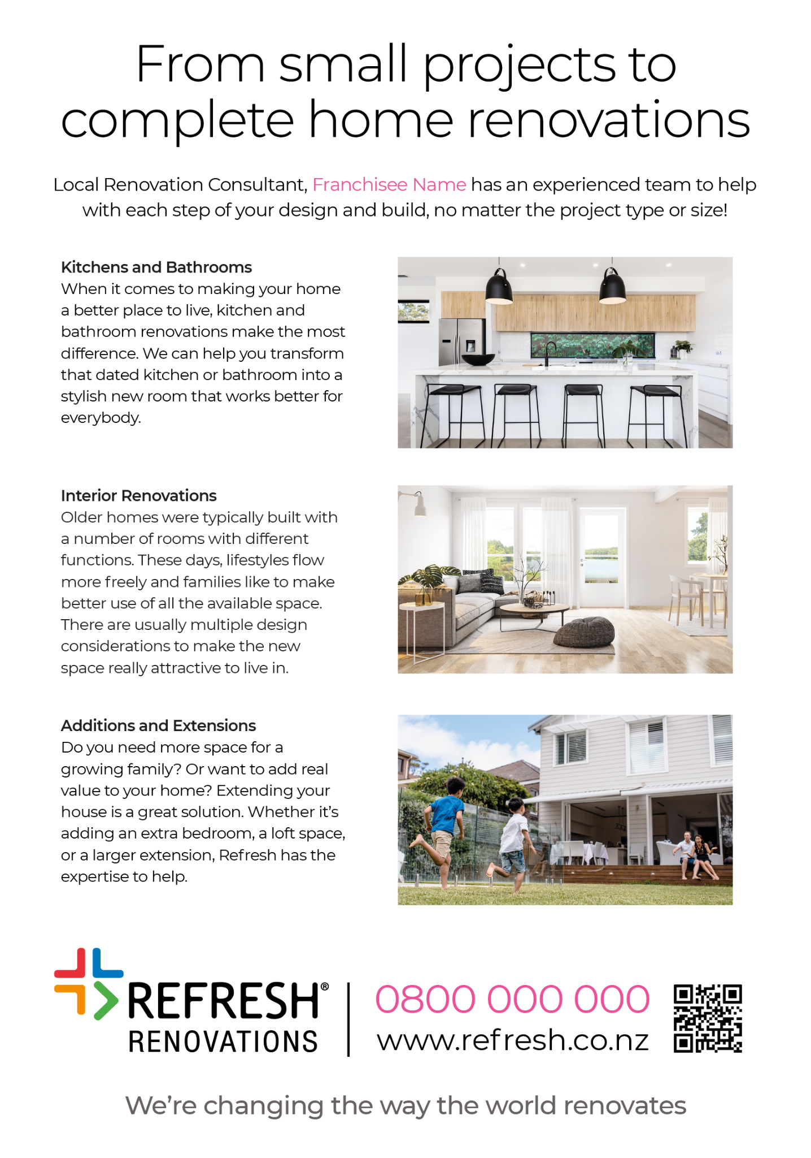
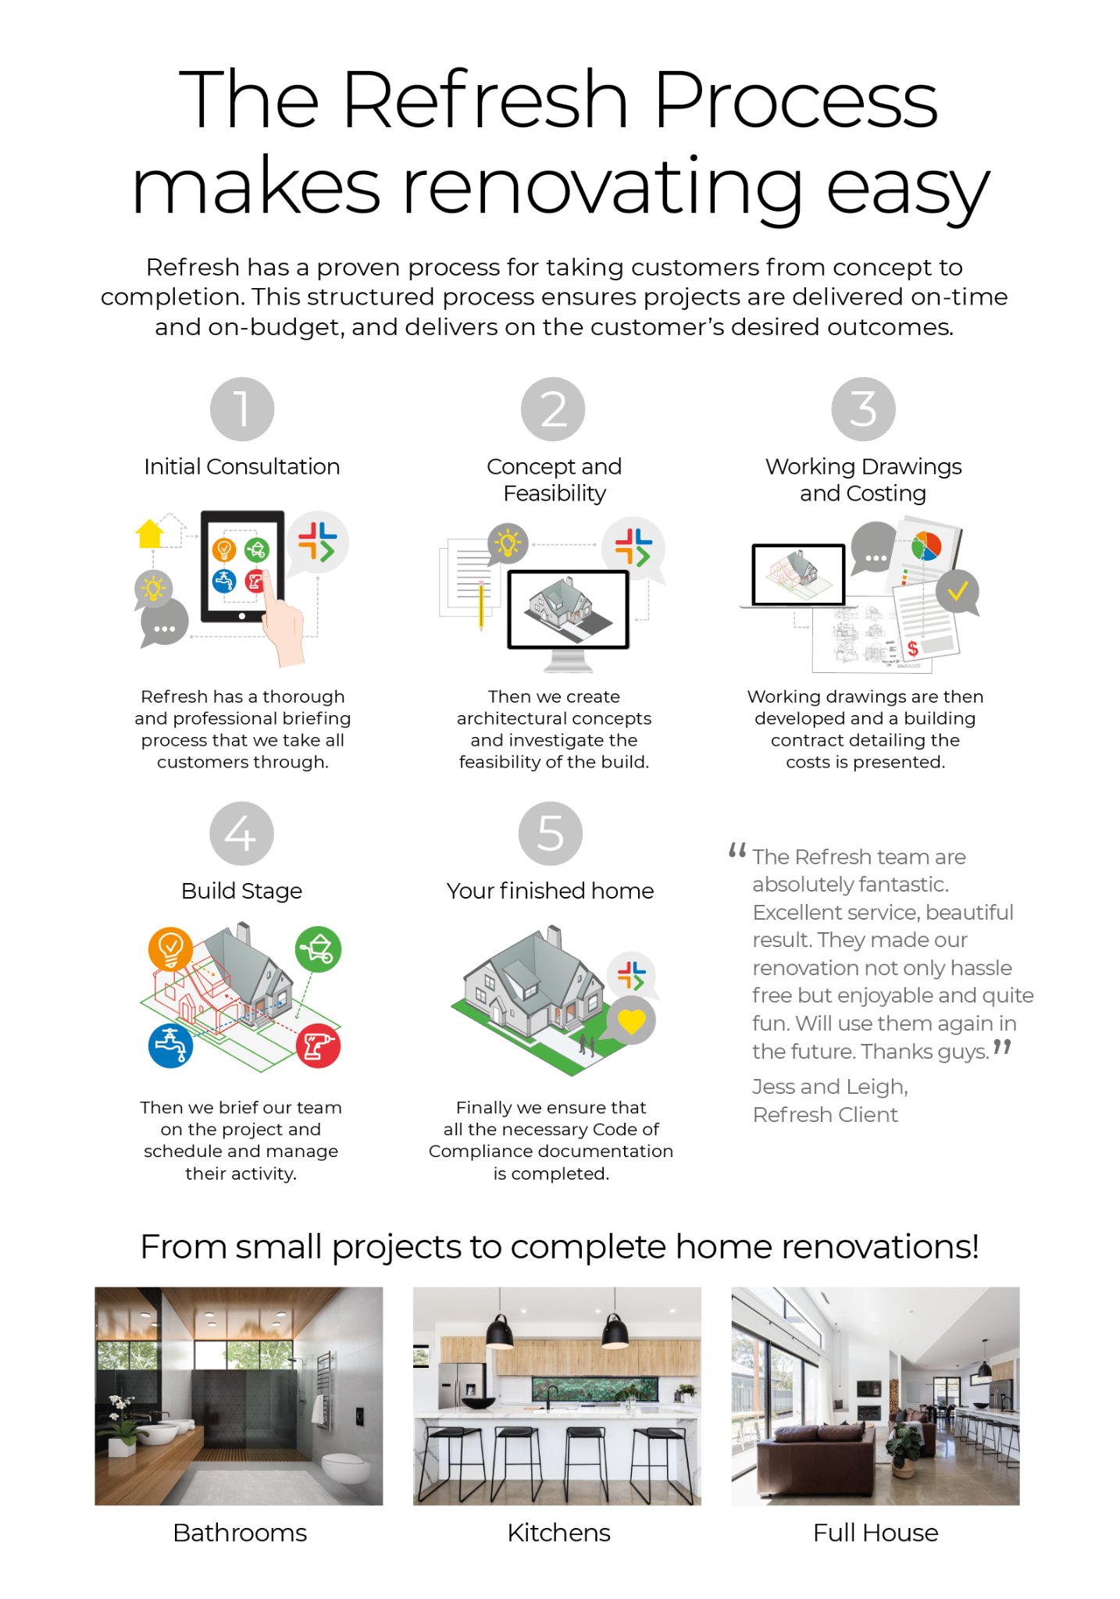
New A5 flyer
Back Option 1
Back Option 2
A5 Flyer
Download Files

Slide 38
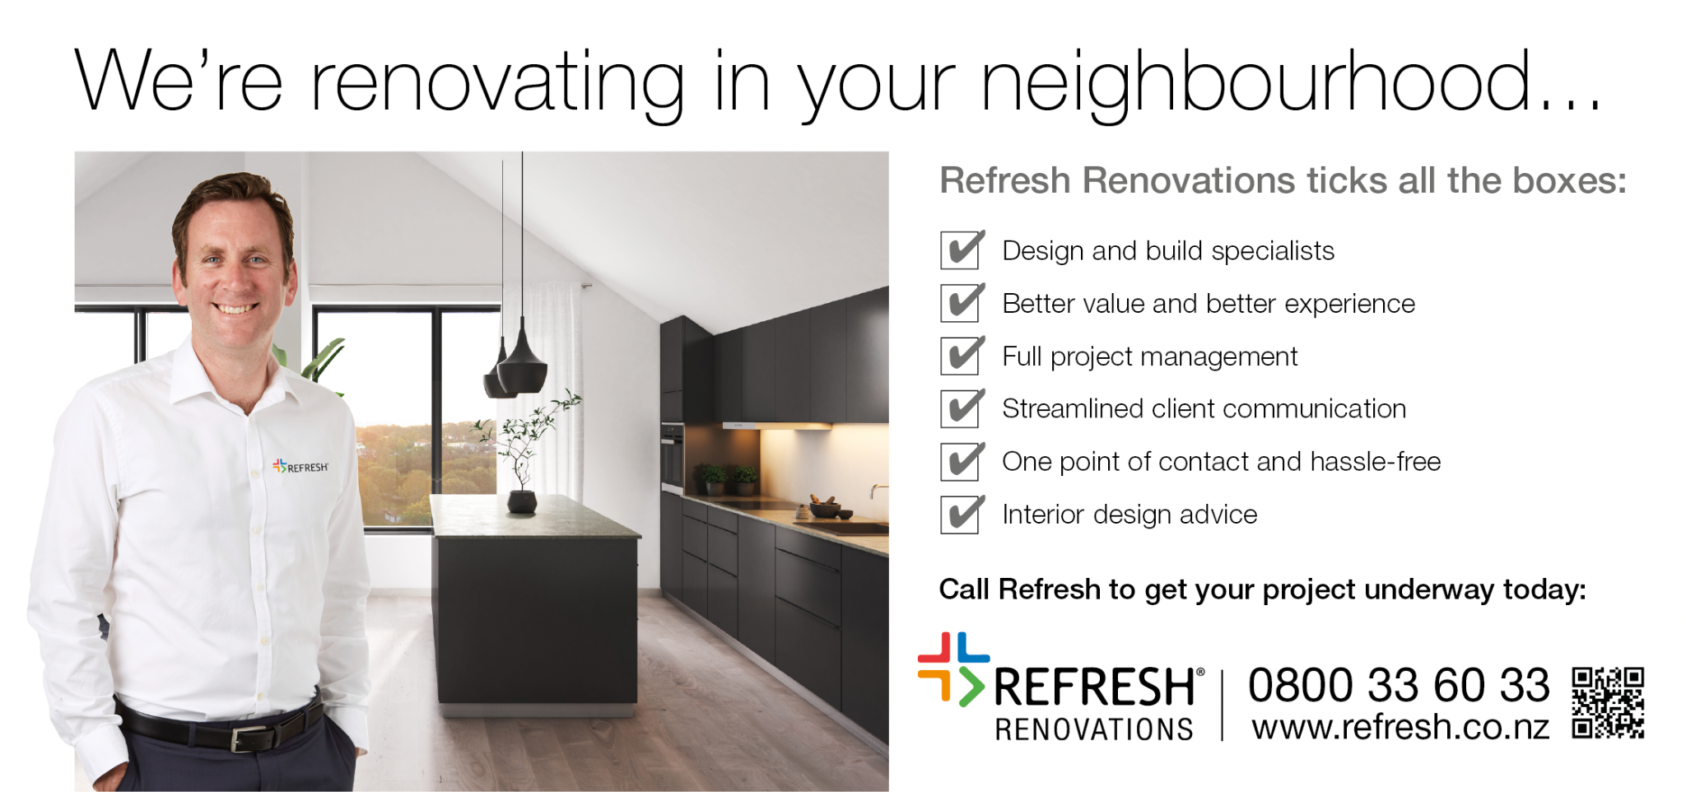
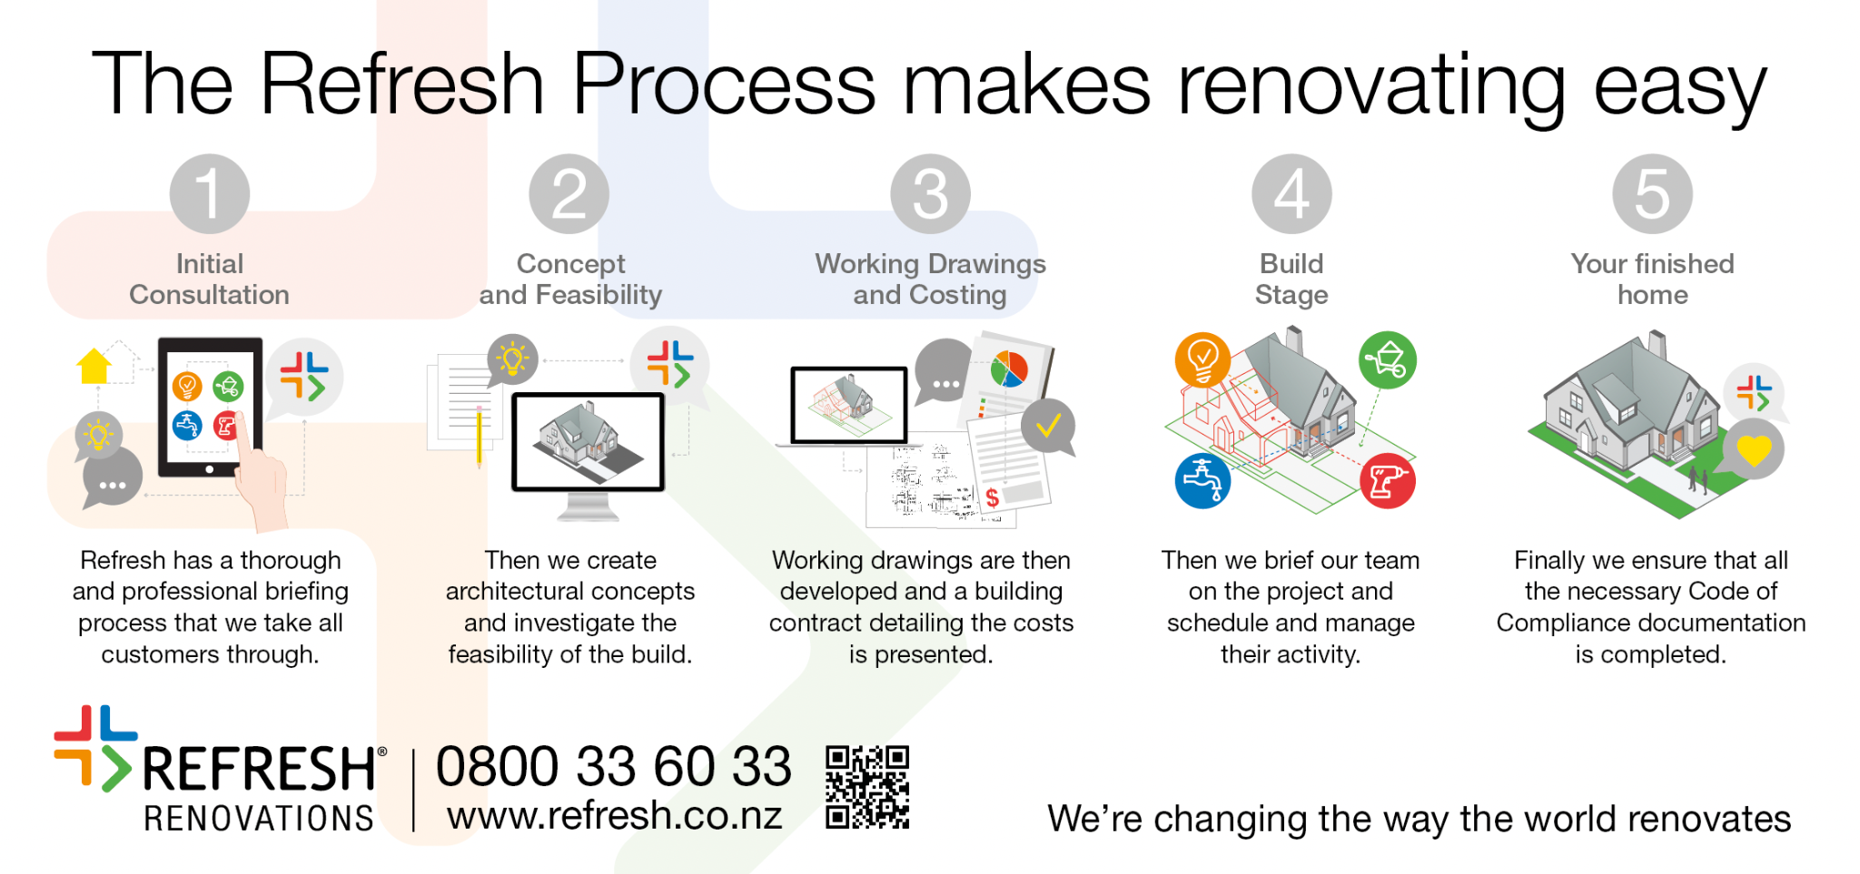
In your area DL flyer
In your area DL Flyer
Download Files

Slide 39
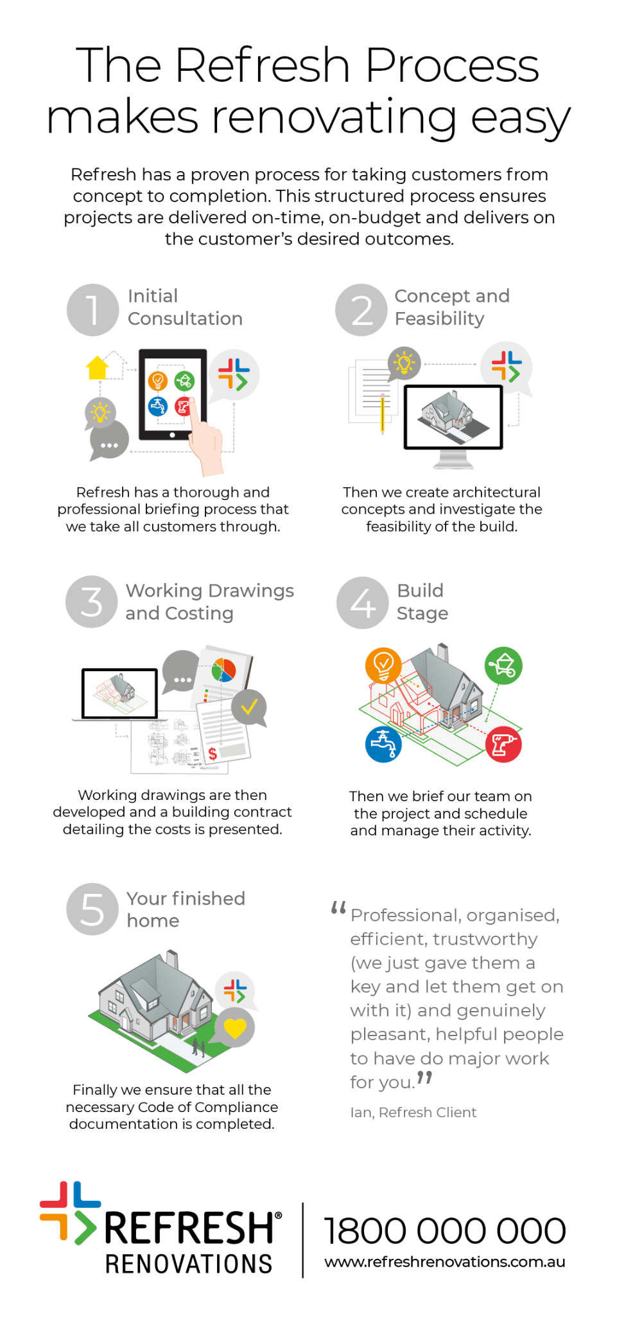
Generic DL Flyer (Available to order online)
Order via these sites
USA: https://www.refreshrenovations.store/home/
AUS: https://opm3.worldwide.com.au/refresh
NZ: https://soarprint.printcost.com/
UK: Order via UK Head Office (Download Files)

Slide 40
Postcard
Postcard
Download Files

Slide 41
Other Local Marketing Templates

Slide 42
Home Show Competition Banners
Pull up banner 1
W850 x H2000
Download Files
Pull up banner 2
W850 x H2000
Download Files
Pull up banner 3
W850 x H2000
Download Files

Slide 43
A5 Seminar Flyer / Poster
Can be scaled up to A3, A2, A1 to create a Seminar Poster.
A5 Seminar Flyer
Download Files

Slide 44
Refresh Home Show Artwork - 3x3 Stand
Can be scaled up to A3, A2, A1 to create a Seminar Poster.
A5 Seminar Flyer
Download Files

Slide 45
Home Show Artwork - Refresh 3x3 Stand
Artwork for stand walls (corflute panels)
Table sign
QR code that links to enquiry form
Home Show marketing support order form (including custom enquiry form)
Refresh 3x3 Stand
Download Files

Slide 46
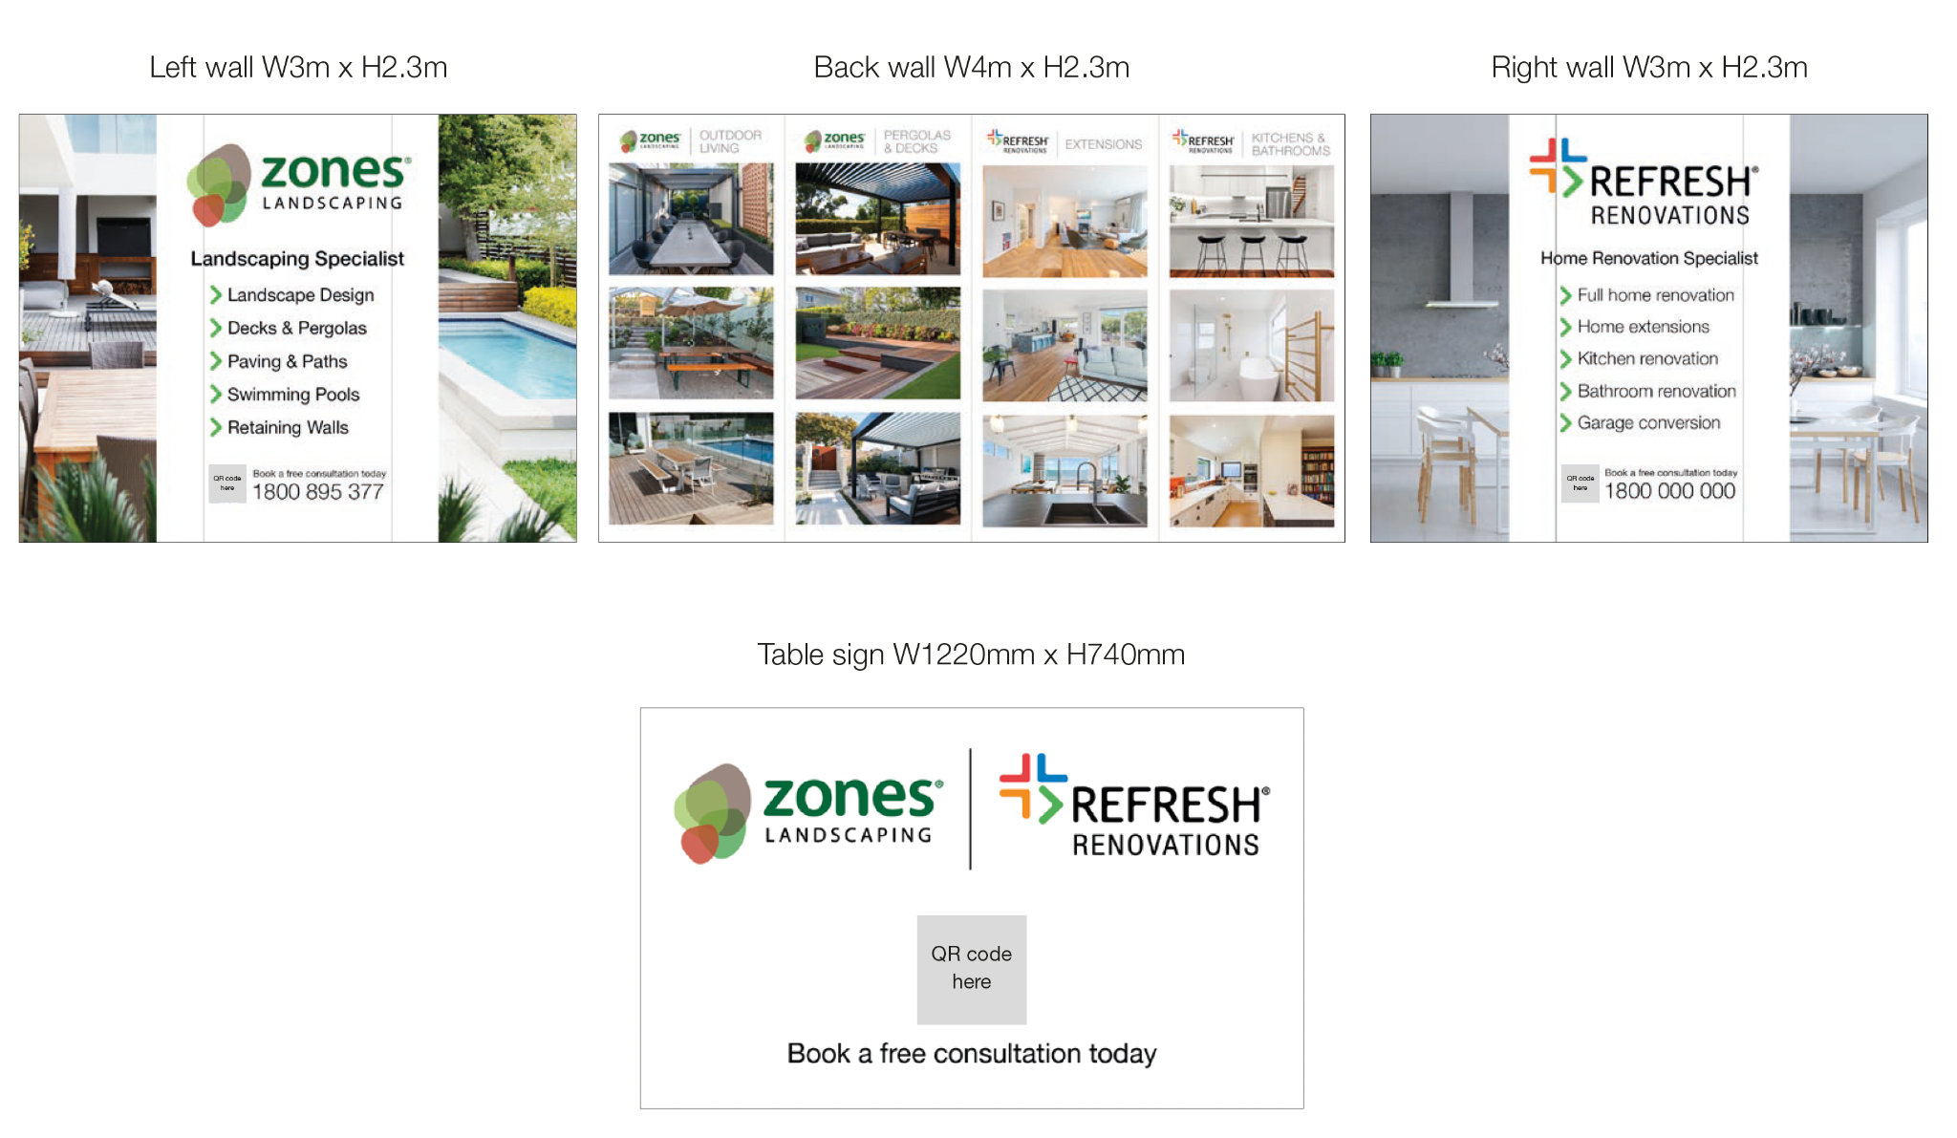
Home Show Artwork - Refresh/Zones 3x4 Stand
Artwork for stand walls (corflute panels)
QR code that links to enquiry form
Home Show marketing support order form (including custom enquiry form)
Refresh/Zones 3x4 Stand
Download Files

Slide 47
Unacceptable Ad Formats

Slide 48
What is not accepted
The following is not permissible on the ads
When reviewing for approval, ensure that you test the phone number to confirm that it rings through to head office
Phone numbers that do not terminate at Head Office
Email addresses
Enquiry forms that do not connect to Control
Poorly designed ads that don’t meet the brand guidelines
Ads that do not champion the brand
Call to action headlines naming a specific franchisee / person (e.g: Call John Smith)
Ads that undermine the brand positioning as defined by Head Office
Ads that undermine Collaborative Business Model
Ads that are not grammatically correct

Slide 49
What is not accepted
The following is not permissible on the ads
Looking For A Cheap Renovation Company?
Not using our approved messaging, wrong font for the heading.
Poorly designed: e.g: Headline is smaller than call to action
Call to action naming person / franchisee
Using own phone number that does not terminate at HO
Using an email address instead of campaign URL
Harry@refreshrenovations.com.au

Slide 50
What is not accepted
The following is not permissible on the ads
Can’t use franchisee name as headline
Ad focusses to
much on individual franchisee
Subhead focuses on contacting franchisee directly
Using own phone number that does not terminate at HO

Slide 51
Headlines that will not be approved
The below headlines will not be approved for use. View list of approved headline examples
[Franchisee Name]
Call [Franchise Name]
We make renovations sooooo easy
Using name
Using name
Bad Grammar

Slide 52
What is not accepted
The following is not permissible on these Google ads
Can’t use franchisee name as headline
Franchelle Oughton | Refresh Renovations Manawatu
Give me a call on 022 122 4307 - I would be happy to help you with your renovation.
Using own phone number that does not terminate at HO
Check out my Facebook
Focuses on contacting franchisee directly / shouldn’t be creating own social page
Notes:
Because we began to receive a lot of requests from franchisees about wanting to create their own social media accounts and engage with their customers,

Slide 53
Project Photography Guidelines

Slide 54
Project Photography Guidelines Summary
Required
After photos professionally photographed following Refresh guidelines on following pages.
Required if submitted to editorial publications (eg news websites)
Online publications always request that project photos have pictures of people in them (eg Homeowners / Renovation Consultant / Franchise Owner / Construction Team / Designers etc).
Required if entering people’s choice awards
Vertical video for promotion on social media.
Preferable
After photos taken from same angle of before and progress photos to enable us to show side by side before and after in marketing.
Before photos and videos (provided in both portrait and landscape mode).
Progress photos and videos (provided in both portrait and landscape mode).

Slide 55
Acceptable Project Photography

Slide 56
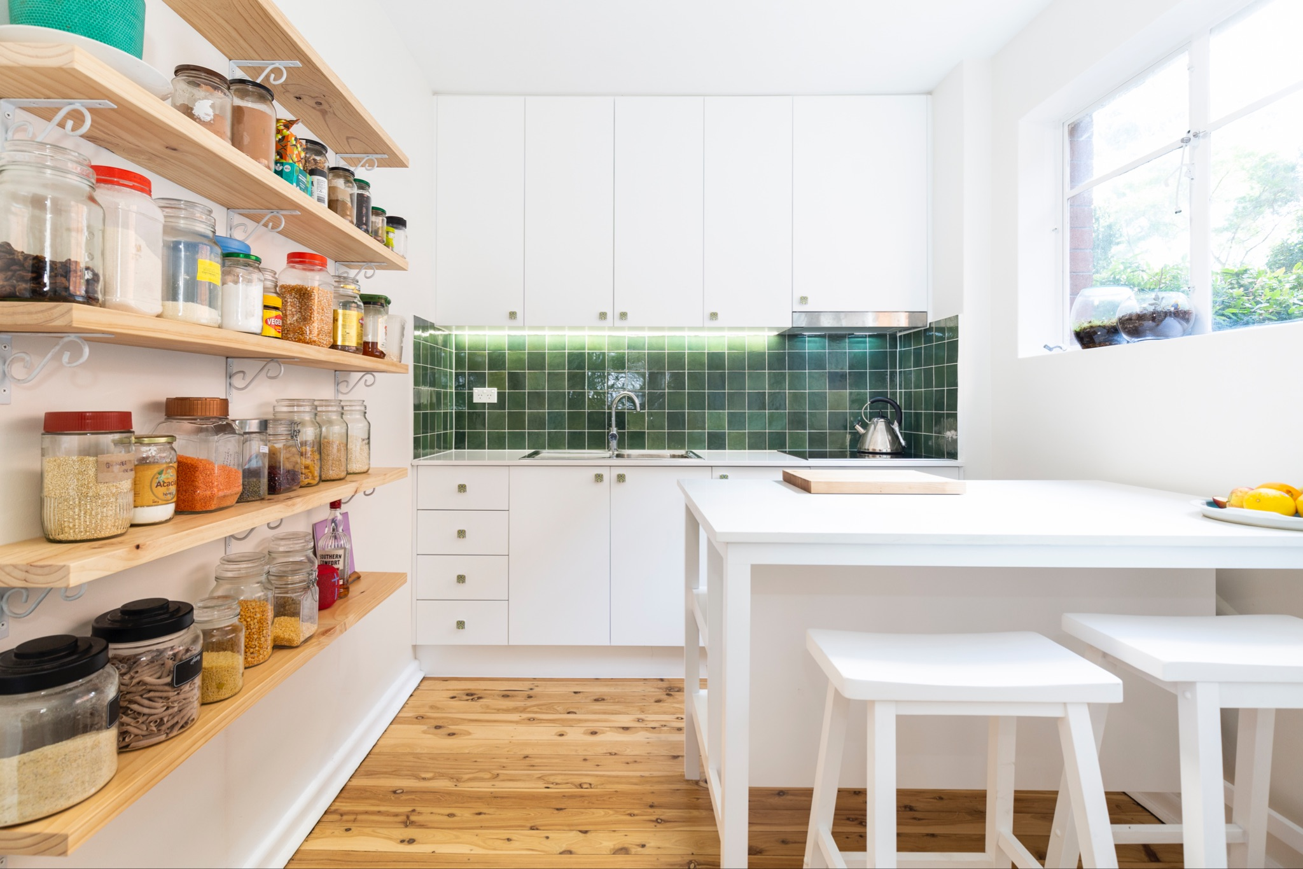
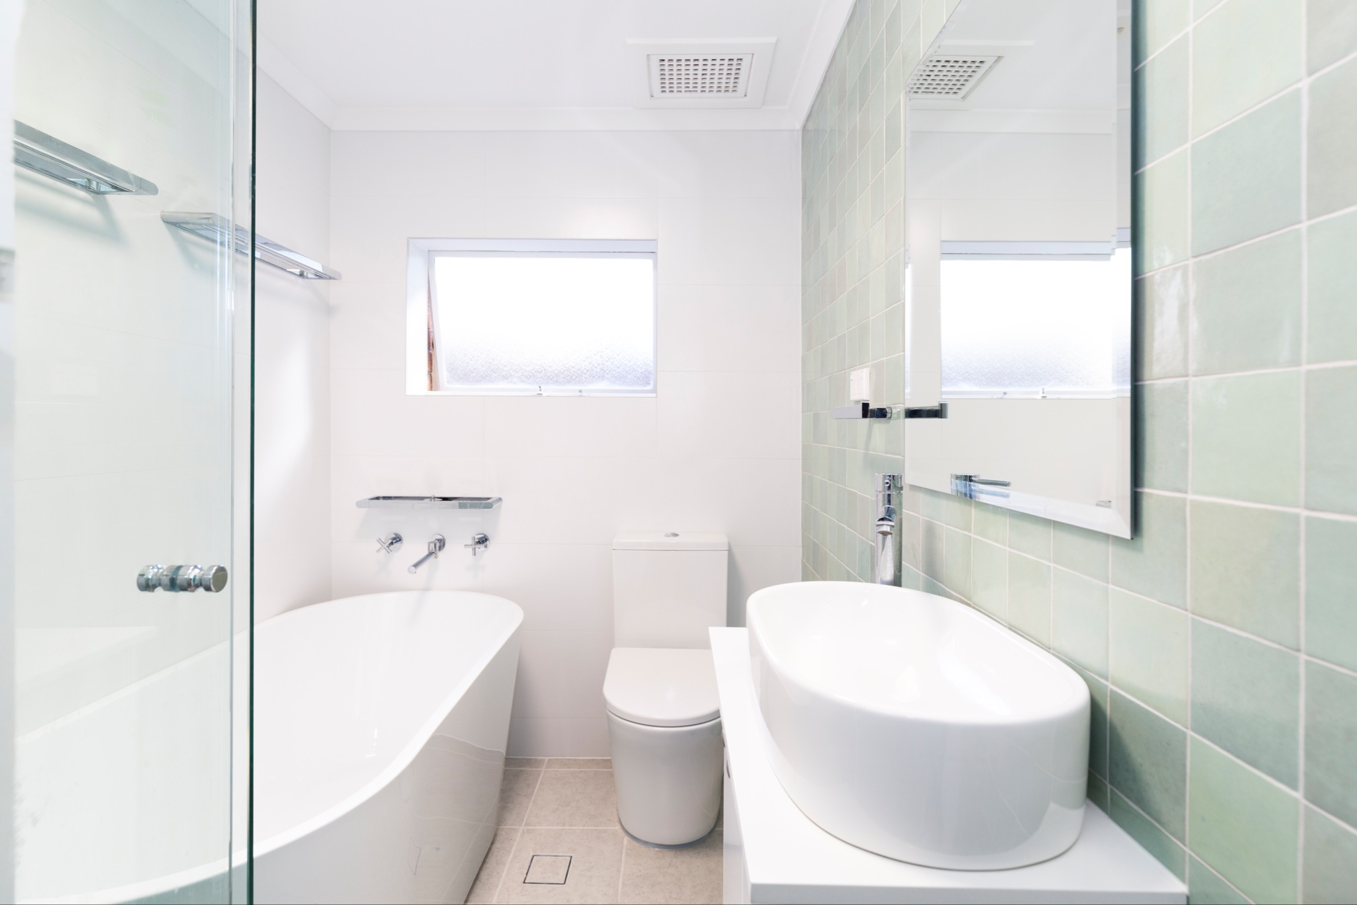
Good Project Photography Examples
Good lighting - Images are nice and bright
Good angle - Easy to see the kitchen and bathroom renovation
Correct perspective - The vertical wall lines are straight and not distorted from using a wide angle lens
Good colour balance - The images look neutral i.e. the they don’t have a yellow, pink or blue tinge to them.
See other good after examples here:
Example 1
Example 2
Example 3
Example 4
Example 5

Slide 57
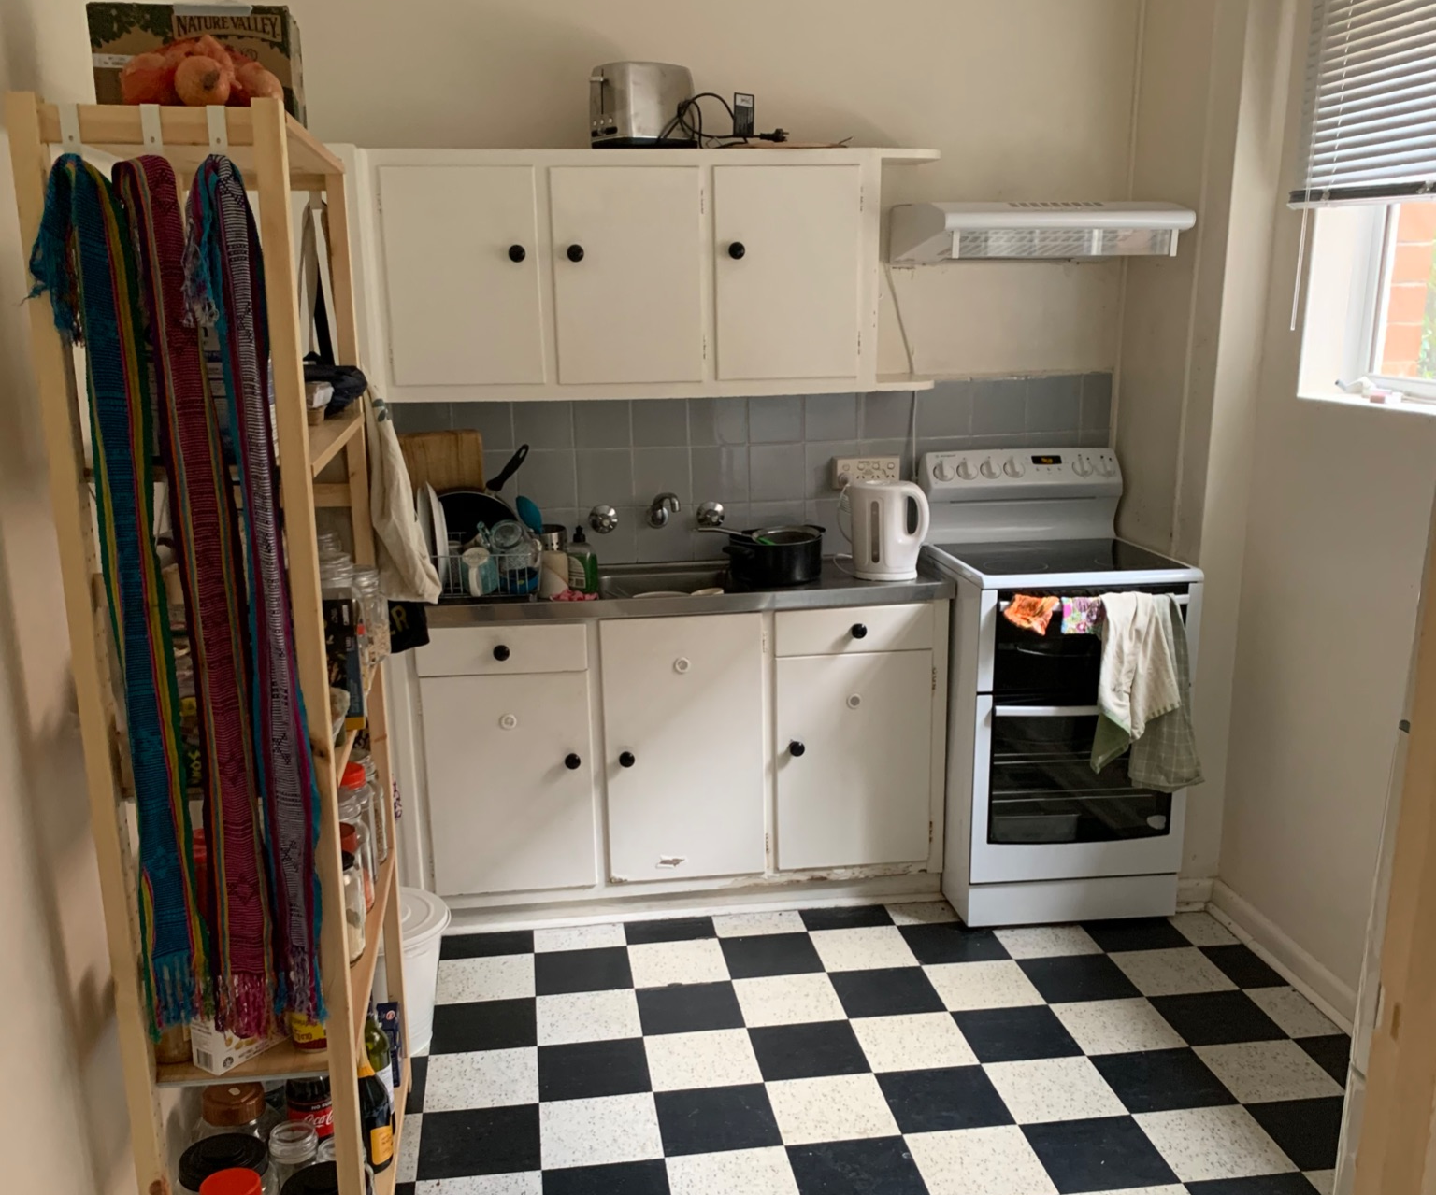
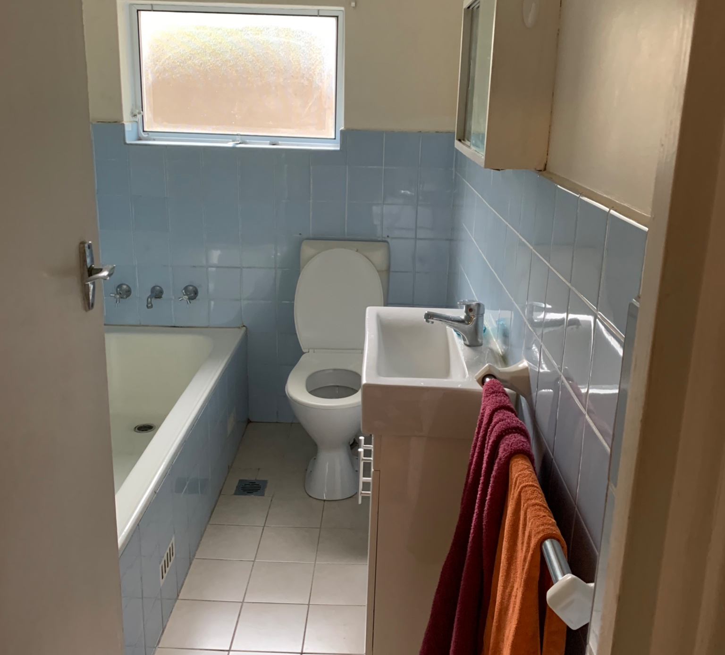
Before Project Photography Examples
Before photos taken from the same angle make it easy for us to display them on our website as before and afters. See an example here.

Slide 58
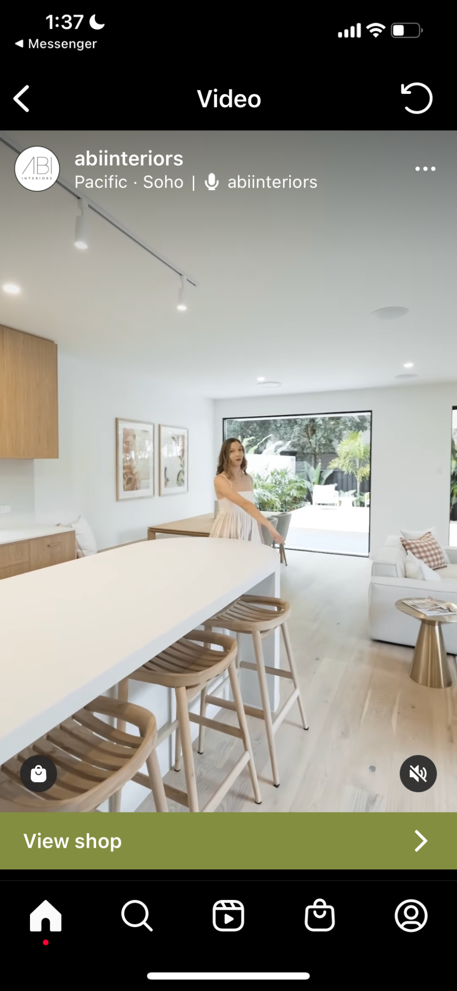
Vertical Video Project Video Examples
Submit vertical videos if you’d like to have your project entered into Peoples Choice Awards
Required for social media and People’s Choice Awards entries
In addition to professional photography vertical video is also required for promotion of project on social media and in the People’s Choice Awards.
Vertical video means holding your phone upright like this when shooting video.
TIP
Using a gimbal will help to reduce shake and noise
Vertical video example
(click here to view a tiktok example)

Slide 59
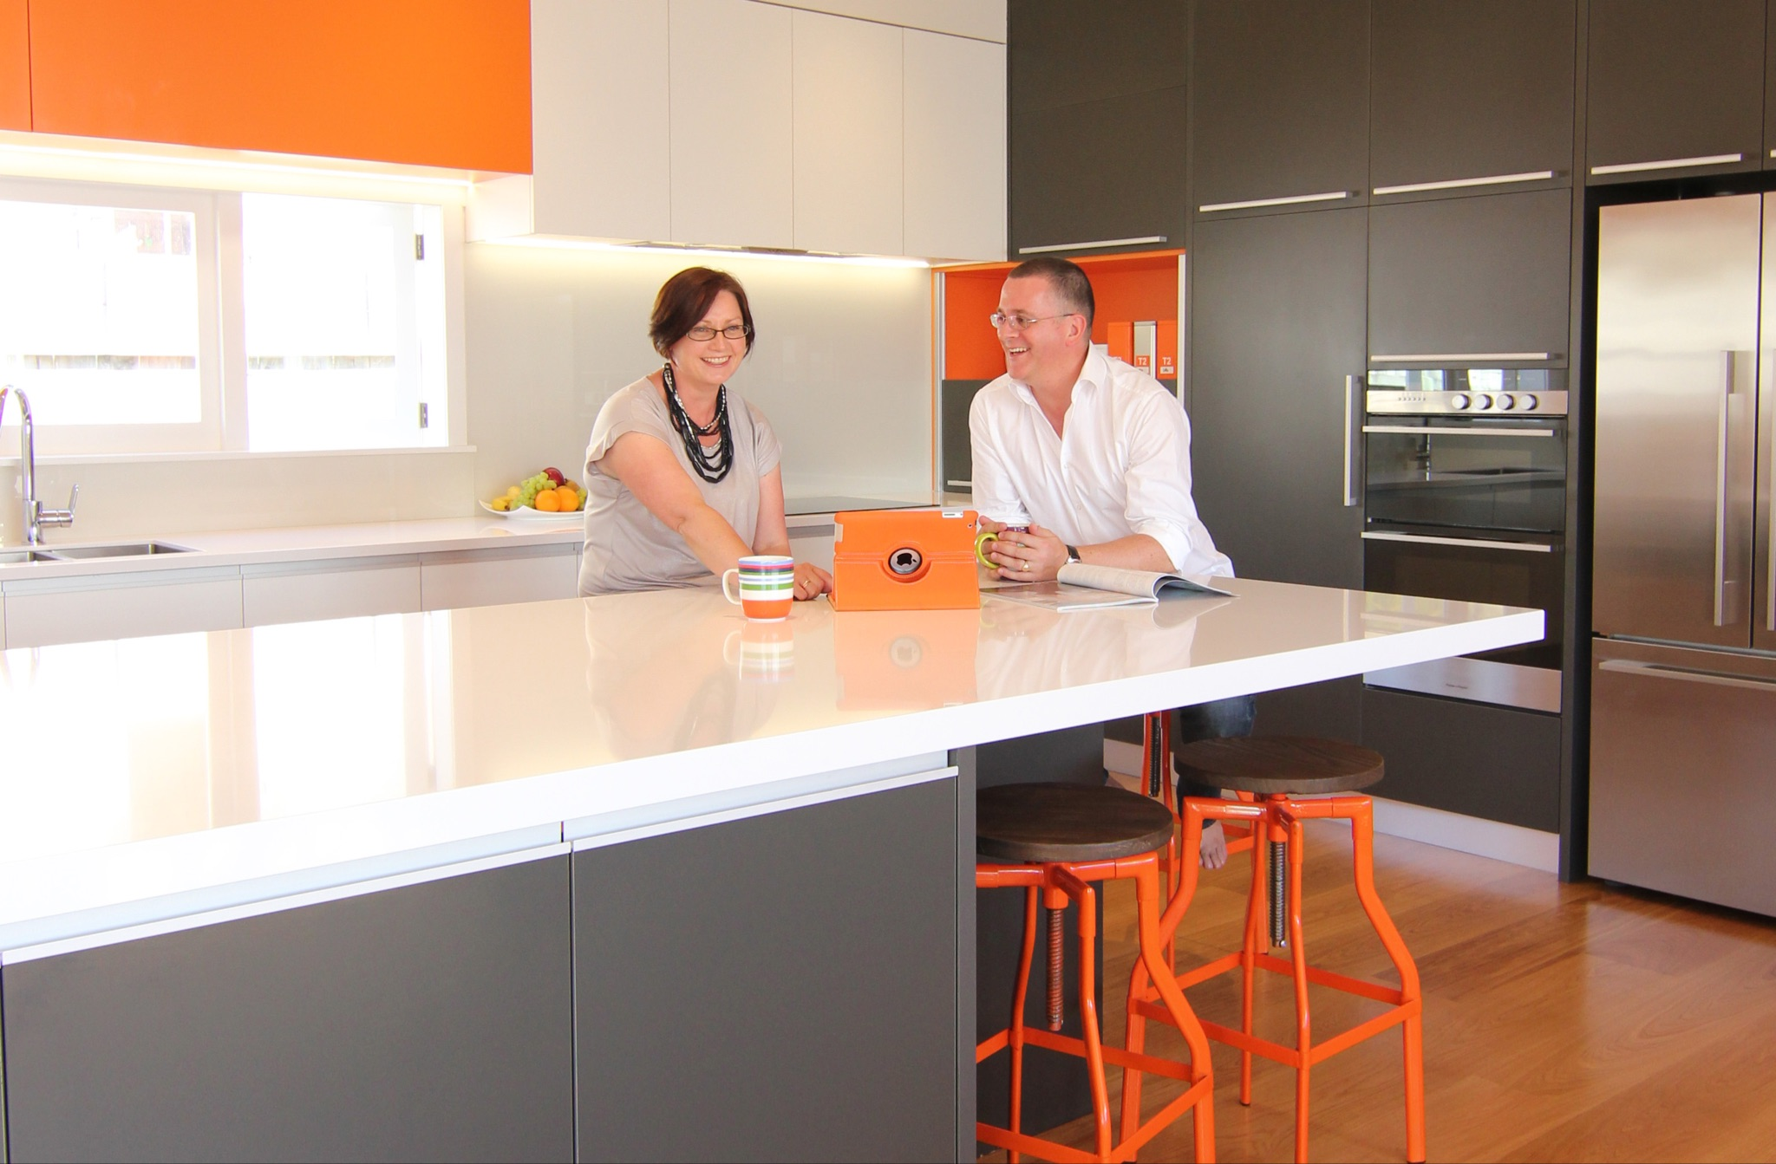
News Media Project Photo Examples
Submit these if you’d like to have your project submitted to the media as a press release
Required
Professional photos of project
Some photos need to have people in them (Homeowners / Renovation Consultant / Franchise Owner / Construction Team / Designers etc)

Slide 60
Unacceptable Project Photography

Slide 61
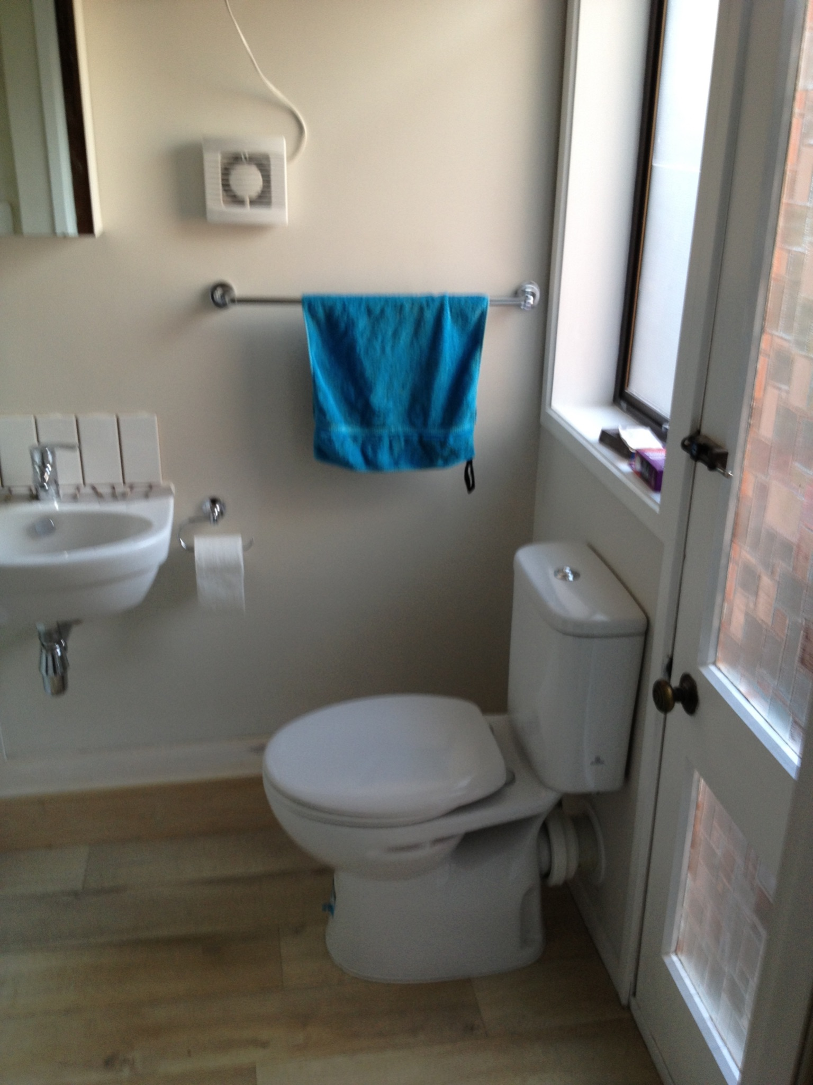
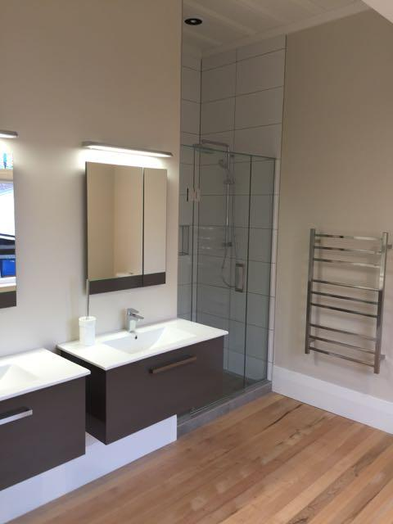
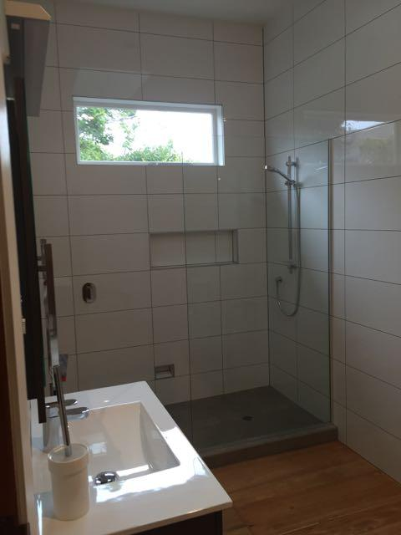
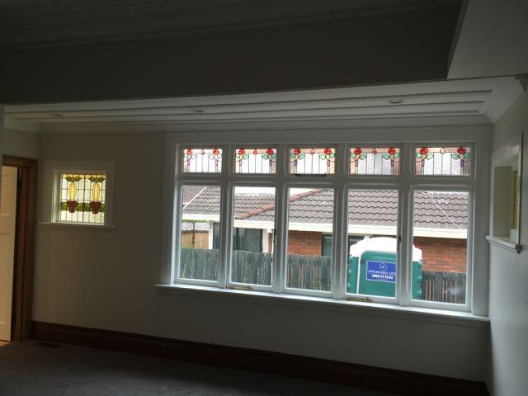
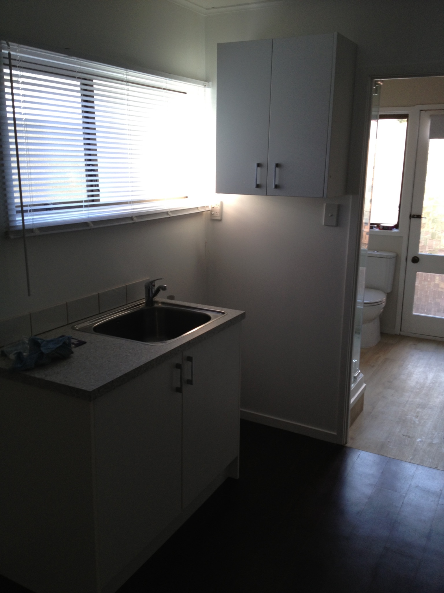
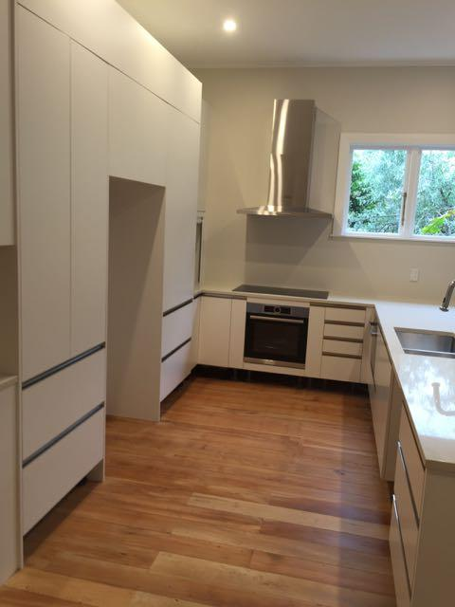
Unacceptable Project Photography Examples
Reason not accepted
Not professionally photographed
Too dark / too bright
Out of focus images
Poor composition / Bad photographic angles
Distorted perspective
Poor colour balance (too pink / blue / yellow)
Untidy room setting
Not a core project - ie: A room tidy up does not warrant having a case study produced
Upon review, supplied images will require too much retouching

Slide 62
Resources

Slide 63
Resources
The following resources will help you with production of your ads
Logo files
Video assets
Request 0800 / 1800 numbers
Request trackable URL
Integrating enquiry form into Control (Send query to web@traffic.net.nz)

Slide 64
Photo Assets
The following resources will help you with production of your ads
Assorted Agency Images (Franchisees on backgrounds / Before and Afters etc)
Project Images for use in: NZ / AU / UK / USA
Stock Images
Find your clear cut Franchisee Photo

Slide 65
Process for requesting approval

Slide 66
Process for requesting approval
Follow this process to get your material approved for you
NOTE: Ensure that you send through the artwork at least 5 working days ahead of deadline to avoid disappointment
At least 5 business days prior to the deadline, forward the ad artwork to design@traffic.net.nz to have it reviewed with the following subject line “Request for approval on [territory] advertisement”
It will either be approved, in which case you can continue
Or if rejected, a reason provided and actionable steps to be taken to bring it inline with the brand guidelines.

Slide 67
Notes / Processes

Slide 68
Lead Management
All leads whether they are generated through channel, customer relationship, digital or from offline local franchise marketing must be entered in Refresh CONTROL before any contact is made
This could include but is not limited to: trackable phone numbers (0800/1800/0508), calls, email enquiries, any local marketing, directory enquiries, referrals, local flyers, digital, building wraps, seminars, social media posts.
The Head Office Customer Service Centre will ensure the:
Leads are not duplicate leads and saves you time contacting another franchisee's customer
The first point of contact is consistent and represents our brand
Head Office can track marketing effectiveness and benchmarking across the group
The customer gets a timely initial response at all times

Slide 69
Marketing - Collaborative Territory Model
Refresh franchisees are working together to build the brand. They are not competing with each other. They are jointly competing against hundreds or thousands of small trade based builders within their territory, and nationally. We are creating a new category in the market.
Consumers are very dissatisfied with the traditional renovation experience, and are attracted to Refresh’s brand driven, and highly professional model.
Marketing scale benefits are attained. Franchisees can jointly participate in marketing activities and spend more money collectively, driving down the cost per lead per franchise. More impactful marketing channels can be used.

Slide 70
Marketing at the highest level
All marketing activities must be undertaken at the highest level possible. This protects the scale of the brand and provides marketing economies of scale with purchasing power.
The only reason why something can be permitted to be done at a lower level is because it can’t be done at a high level. Every effort must be made to engage at the highest level possible and collaborate (ie: Join their budgets and efforts together for better marketing scale - not compete with each other within the group)

Slide 71
Marketing not permitted outside of your territory
Marketing is not permitted outside of your territory - see below excerpt from franchise agreement for your reference

Slide 72
Two options for Call to action in your advertising
All leads whether they are generated through channel, customer relationship, digital or from offline local franchise marketing must be entered in Refresh CONTROL before any contact is made - to support this, there are two options for Call to action in your advertising
Trackable phone number that terminates at Head Office
Trackable URL that redirects user to national website
Click here to submit a request to Head Office to have a Trackable 0800 / 1800 / 0508 Number set up for your campaign
For more information on our 0800 / 1800 / trackable number policy - please review this guide
You can have as many as many trackable numbers as required to track your various campaigns, but you are responsible for paying for them.
Part of the set up involves integration with Control so that when someone calls the number, it creates a lead in Control with the assigned tracking information.
Do not create your own 0800 / 1800 / 0508 Numbers by bypassing head office.
Submit a request to info@refresh.co.nz to request a trackable URL be created, the following information is required.
Franchisee Name
Link to Franchisee Profile on website
Do not display email addresses in your advertising / marketing material, rather make use of trackable URLs

Slide 73
How a trackable URL works
1.
2.
3.
User views an advert with trackable URL shown as call to action
E.g: If entered refreshrenovations.com.au/PaulCree/
When user types friendly trackable URL into Internet browser, the browser redirects to the full tracking URL, E.g:
If users enters refreshrenovations.com.au/PaulCree/
Browser will open the following website with tracking: https://www.refreshrenovations.com.au/about-us/people-and-culture/paul-cree-melbourne-renovation-builder/?utm_source=Franchise%20generated&utm_medium=Local%20Franchise%20Marketing&utm_campaign=Paul%20Cree
So that when an enquiry created in Control by someone who used that link, it will have the tracking information associated with the URL captured to inform allocation to that franchisee: e.g:
Source: Franchise generated
Medium: Local Franchise Marketing Campaign: Paul Cree

Slide 74
Trackable 0800 / 1800 / 0508 Numbers
Franchisees are not permitted to advertise their personal mobile phone number / office / landline in relation to the Franchised Business. The Franchisee is required to set up and must only use a trackable 1800 number as prescribed by the Franchisor in the Franchised Business
What you need to do:
Fill out this form here to order your trackable number
Use it where appropriate in local marketing
For more information on which phone number to use for different marketing communications, review the Phone and Email policy.
Franchisees are not permitted to use advertising that directs enquiries to their own mobile phone / office / landline
All leads from advertising must use approved phone numbers which are answered by head office, not the franchisee's business or other agent
Franchisees are not permitted to use unapproved numbers on advertising which bypass the head office call centre.

Slide 75
Brand Communication - Service Differentiation Doc
REFRESH
ZONES
ONCORE
Renovations
Outdoor Renovations
Design and Build
Project Management
Renovation Consultant
Builder
Landscaping
Architects
Landscaping
Outdoor Renovations
Design and Build
Project Management
Landscaping Consultant
Landscaping Company
Landscape Design
Renovations
Architects
Restoration
Reinstatement
Project Management
Oncore Owners
Design and Build
Architects
Renovations
Landscaping
Landscaping Consultant
Renovation Consultant
Outdoor Renovations
Builder
Yes No
Yes No
Yes No

